Slide 1

Use Errors
ENP 111 – Use Related Risk Analysis
Sami Durrani PhD and Eric Bergman PhD
Notes:
Quick introductions

Slide 2
What is a use error?
FDA definition: User action or lack of action that was different from that expected by the manufacturer and caused a result that:
(1) was different from the result expected by the user and
(2) was not caused solely by device failure and
(3) did or could result in harm

Slide 3
Let’s look at a few case studies

Slide 4

Hospital Bed
A hospital staff member is transporting a hospital bed from one room to another.
After positioning the hospital bed in the new room, the staff member is unsure of the exact desired bed placement, so decides to leave without locking the brakes to enable the station nurse to easily reposition the bed.
The staff member meant to inform the duty nurse that the bed’s brakes were not set but forgets to do.

Slide 5

Hospital Bed
New patient arrives and the duty nurse helps patient into bed. Nurse starts to pull the side rails up, which causes the bed to move and spin out of control.

Slide 6

Hospital Bed
Thankfully, the nurse was able to catch the bed and secure it before anyone was hurt

Slide 7
Previous scenario as a poem
In a bustling hospital's echoing hall, a bed transported, wheels and all. From one room to next, it made its trip, with each turn and twist, a careful grip.
The staffer, with intent so kind, left the brakes unset, it slipped his mind. Thinking the nurse would adjust its station, he left, lost in his next task's fascination.
But as fate would have it, the tale unfolds, a new patient arrives, a story yet untold. The duty nurse, with care profound, helps the patient, with soft voices around.
Yet as he reached to secure the rail, the bed began to drift, starting a frail tale. It spun and twirled, a dance so wild, danger lurking, for nurse and the beguiled.
But quick in thought and swift in action, the nurse's grip became the main attraction. With strength and grace, he steadied the ride, ensuring the patient's safety, with pride on his side.
A lesson learned in that fleeting spell, in a hospital’s dance, where stories dwell. For in moments of haste, things may go astray, but vigilance and care will save the day!

Slide 8
Hospital Bed
Was there a use error?
Was there only one? Or multiple?

Slide 9
Hospital Bed
A hospital staff member is transporting a hospital bed from one room to another.
After positioning the hospital bed in the new room, the staff member is unsure of the exact desired bed placement, so decides to leave without locking the brakes to enable the station nurse to easily reposition the bed.
The staff member meant to inform the duty nurse that the bed’s brakes were not set but forgets to do.

Slide 10
Hospital Bed
New patient comes.
Duty nurse helps patient into bed, and starts to pull the side rails up, which causes the bed to move and spin out of control

Slide 11
Hospital Bed
Thankfully the nurse was able to catch the bed and secure it before anyone was hurt

Slide 12
Hospital Bed
Was there a use error?
Yes
Was there only one? Or multiple?
Errors:
Unsure of bed placement/location
Does not lock brakes
Forgets to inform nurse that brakes not set
Does not set brakes before helping patient into bed
Not USE Error
USE Error
Not USE Error
USE Error
Notes:
Worth noting that this entire topic is “fraught” and that there are some professionals out there who would say that some of these ARE use errors. We disagree, of course.

Slide 13
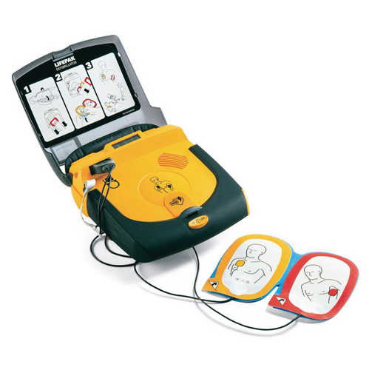
Automated External Defibrillator (AED)
Scenario: A layperson, trying to use an AED in an emergency, misreads the instructional graphics on the inside of the AED’s cover.
As a result, the layperson places the adhesive electrode pads in incorrect locations on the person suffering cardiac arrest’s chest before delivering the AED pulse. But thankfully, the AED pulse still saves the person’s life.
Did a use error occur?
Yes
Notes:
What is the use error?

Slide 14
Errors in writing use errors
Notes:
Make sure to explain that here we provide tips to write use errors that are accurate and well described

Slide 15
Not being specific enough
User stores device incorrectly
User stores device in temperatures below -5F
User enters incorrect patient information
User enters patient’s date of birth incorrectly
User dials wrong dose amount
User dials dose amount 0% < 20% prescribed
User dials dose amount 20% < 50% prescribed
User dials dose amount >50% prescribed
User dials dose amount 0% > 20% prescribed
…and so on
Notes:
The consequences, and hence harms or the severity of the harms (if the harms are the same) could be quite different for these different specific scenarios.
Being specific also helps with designers and engineers develop proper mitigations. Its important to note that often use errors will form the basis of requirements and unclear use errors can lead to unclear requirements which can lead to mitigations that are not sufficiently effective.
Also, being specific can help you when developing your validation test and setting your pass/fail criteria.
All this said, being too specific can also cause issues by leading to mitigations that don’t sufficiently generalize to a range of use scenarios. For example, if you neglect to account for “user dials wrong dose amount” leading to underdose, then the analysis will be incomplete.

Slide 16
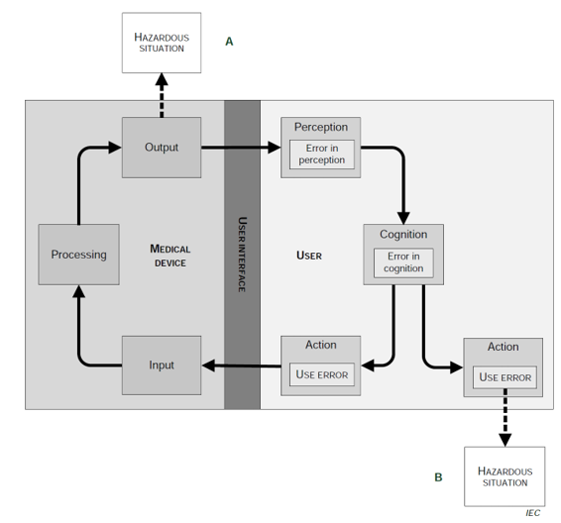
Before we go on: PCA model refresher
AAMI/IEC TIR62366-2
Notes:
The Perception, Cognition, and manual Action (PCA) model may be used to further break down user interactions into specific user actions related to perceptual inputs, cognitive processing, and physical actions involved in performing the related step. [3].
Using the PCA model, tasks are decomposed down to the level of individual user interactions related to:
1) Perception – Perceptual information to be noticed or detected by the user.
2) Cognition – Cognitive components to be interpreted by the user.
3) Action – Physical actions taken by the user.
Using the PCA model assists manufacturers in understanding the different PCA elements required for each task and further delineate use errors that may occur if the user if unable to meet these requirements. Additional steps or tasks may be revealed or uncovered that manufacturers were previously unaware of or may have glanced over in the initial task list.
Potential use-related problems can be identified by asking the following questions [2]:
1) What if the user is unable to perceive x?
2) What if the user is unable to interpret/process y?
3) What if the user is unable to perform action z?
Although use errors are ultimately bound to an action (or inaction), analysis of perceptual information and cognitive elements may inform the cause of use errors that may occur. This breakdown of use errors then allow manufacturers to further inform their use-related risk analysis (URRA).

Slide 17
Use error definition refresher
FDA definition: User action or lack of action that was different from that expected by the manufacturer and caused a result that:
(1) was different from the result expected by the user and
(2) was not caused solely by device failure and
(3) did or could result in harm
Key Point: Use errors are expressed by physical action or lack of required action

Slide 18
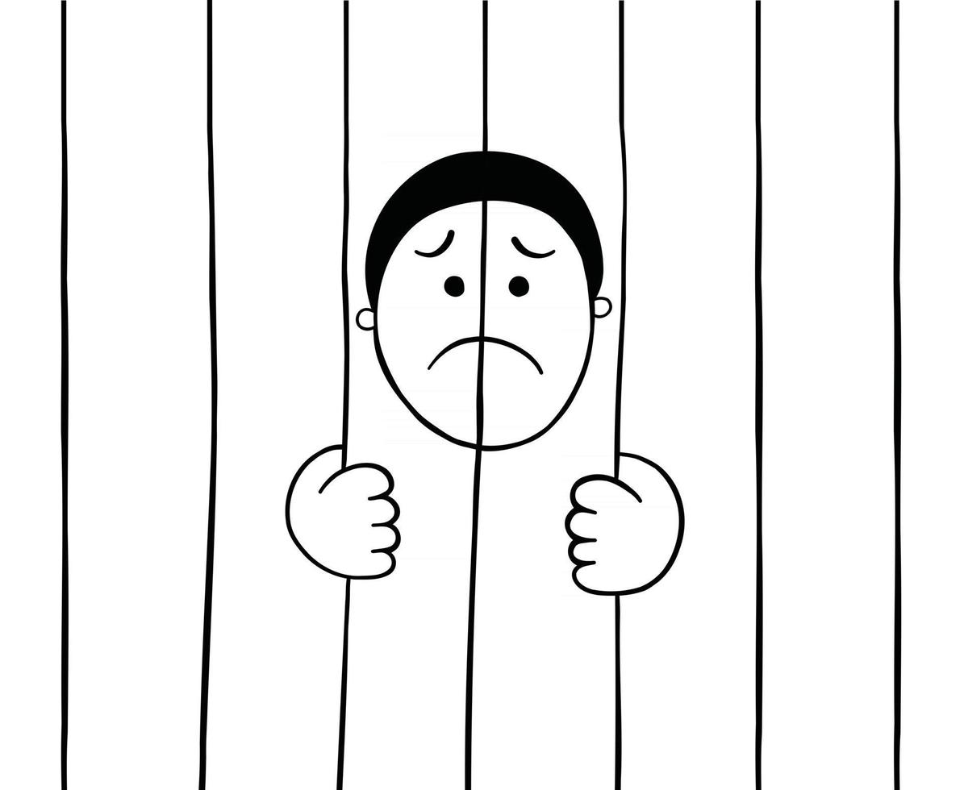
Writing use errors that don’t include an action
Common mistake to use Perception Cognition and Action (PCA) model in task analysis to define a “use error” for each PCA line
For example:
User does not see warning
User does not comprehend instructions
Use errors are physical action based
You can’t be jailed for thinking about stealing You actually have to steal
These are not use errors

Slide 19
Incorrectly writing causes as use errors
User is inexperienced
User does not understand training
User does not hear alarm “X”
User does not respond to alarm “X”
User transposes numbers when reading prescription card
User dials dose amount 0% < +20% prescribed
…etc
Notes:
Another common error, often stemming from PCA analysis, observed issues in usability testing or field complaints. Do not confuse reasons for a use error for the use error itself. This is a bit tricky, because the line isn’t always clear and here experience and judgement do come in. Sometimes its clear, sometimes its not. We’ll continue to tackle this via example throughout the semester.
For example, this first example. … I’ve seen 1000+ line items URRAs because they start listing every possible way something can get damaged.

Slide 20
Use errors that are not testable/observable
User does not check drug for discoloring
User injects drug that is discolored
User does not check device for leaks
User uses vial with leaking fluid
Home patient does check not expiration date on oral medication
Patient takes expired oral medication
Notes:
This one is a bit about strategy. As an HF engineer, you want to develop a good product that safe and effective, but you also don’t want write user errors that artificially end up causing you to fail your HF validation study. There is no point in developing a great product that you can’t get to market because you hampered yourself in conducting your HF study.
On User does not check device for damage, be careful on wording selection. If you said user selects instead of uses, you might have ended up with a use error even the user did not actually intend to ever use it.

Slide 21
Writing a sequence of events as a use error
User enters incorrectly high blood glucose value into an insulin dose calculator, which provides a 3x dose recommendation, leading user to overdose
User incorrectly enters blood glucose value >X%
Notes:
Particularly common in software as medical devices because often the harm is indirect.
It is important to note that the sequence of events is important, and that this point should not confuse you into thinking that one more use errors cannot contribute to a subsequent use error. They can, but in the example above, incorrectly entering the value is not necessarily a use error.

Slide 22
Bonus!
Where possible, write use actions so that they directly link to the action that can cause harm
User dials dose amount 0% < +20% prescribed
User injects dose amount 0% < 20% prescribed
Use words that imply actual device or medical operation, for example:
User injects
User infuses
User operates
..etc
Notes:
Ensure use action leading to harm is complete!

